Slide 1



Job Market Analysis & NLP Recommendation System
An End-to-End Machine Learning, Deep Learning & Transformer Deployment Project
SUBMITTED TO
SUBMITTED BY
NextHikes
Rajbir Kaur

Slide 2



Project Overview & Core Objectives
Primary Objectives
Key Engineering Milestones
Classification: Automatically classify job postings into tech domains using NLP.
Benchmark 5 Supervised Classifier Architectures on TF-IDF.
Demand Forecasting: Predict future monthly posting trends using time-series models.
Compare Statistical (ARIMA) vs Deep Learning (LSTM) forecasting.
Recommendation: Semantic vector matching with transformer models and business filters.
Deploy Streamlit Interactive App containerized via Docker.

Slide 3
Classification Model Performance Comparison
Model Name | Accuracy (%) | F1-Score | Computational Overhead | Status
Logistic Regression (TF-IDF Baseline) | 97.00% | 0.97 | Very Low (< 1 min) | Selected Baseline Optimal
Multi-Layer Perceptron (Neural Net) | 96.41% | 0.96 | High (Iter limit 30) | Strong Alternative
Random Forest Classifier | 95.96% | 0.96 | Medium | Evaluated
XGBoost Classifier | 92.89% | 0.93 | Medium-High | Evaluated
Decision Tree Classifier | 87.38% | 0.87 | Low | Baseline

Slide 4
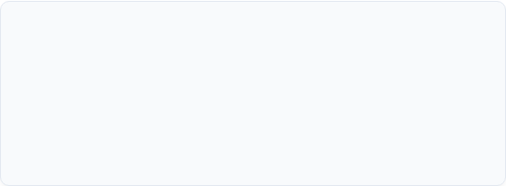
Selected Classification Model: Logistic Regression
Mathematical & Structural Fit
Speed & Resource Efficiency
TF-IDF feature extraction generates high-dimensional, sparse matrices. Linear classifiers like Logistic Regression excel in high dimensions because linear hyperplanes separate classes efficiently without overfitting.
Achieved top performance (97.00% Accuracy, 0.97 F1-Score) while requiring significantly lower training time and compute compared to MLP, XGBoost, or Random Forest ensembles.

Slide 5

Neural Network (MLP) Classifier Performance
Overall Accuracy: Achieved 96.41% accuracy across 29,534 test instances despite hitting max iteration cap (30).
Class Balance: Balanced precision and recall across all four domains (0.94 - 0.98).
Key Insight: Captures subtle non-linear dependencies in text embeddings but demands higher runtime.

Slide 6

Gradient Boosting (XGBoost) Breakdown
Overall Accuracy: Achieved 92.89% (0.93 weighted average) on 29,534 test samples.
Perfect Precision: Scored 1.00 precision in 'AI & Data Science' with 0.78 recall (F1: 0.88 across 6,461 samples).
High Performers: Design & Creative achieved 0.97 F1-score; Web & Dev scored 0.95 F1-score.

Slide 7

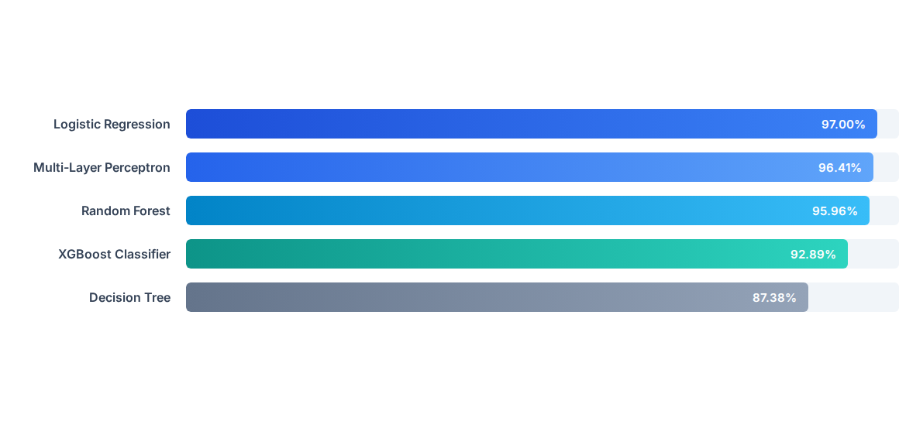
Category-Wise Classification Accuracy Overview

Slide 8



Time-Series Forecasting: Model Selection
ARIMA (Statistical Model)
LSTM Deep Learning (Selected)
Projected unbounded, strictly linear growth. While useful for simple trends, ARIMA failed to model post-expansion saturation or cyclical market corrections.
Captures complex non-linear temporal dynamics and post-surge stabilization. Forecasts realistic steady-state job postings (92k - 103k monthly) for strategic platform planning.

Slide 9

LSTM Neural Network Demand Forecast Plot
Historical Rise: Minimal volume Dec 2023–Feb 2024, followed by a surge to ~102,000 in March and ~143,000 in April 2024.
Projected Stabilization: May 2024 (~101k), June 2024 (~103k), and July 2024 (~92k).
Business Impact: Prevents over-provisioning infrastructure during temporary market spikes.

Slide 10

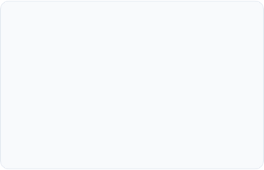
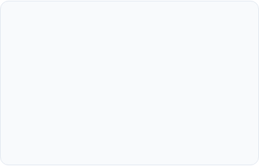
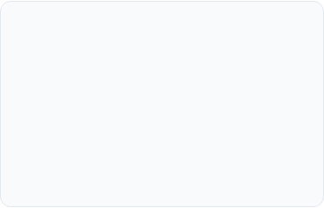



Transformer-Based Recommendation System
1. Semantic Embedding
2. Cosine Proximity
3. Business Filters
Utilizes HuggingFace Sentence-BERT (all-MiniLM-L6-v2) to encode job text into 384-dim dense vectors.
Computes similarity scores between user query vectors and cached job posting embeddings.
Enforces dynamic constraints (e.g., Minimum Budget ≥ $500) post similarity scoring.

Slide 11

Sentence-BERT Query Matching Execution
Exact Matches: User query 'Data Scientist' yielded 100.00% match scores on identical job titles.
Contextual Matching: Captured semantically related roles like 'Data science developer' (85.81%) and 'Data Engineer' (81.36%).
Budget Range: Successfully retrieved qualified jobs ranging from $800 to $21,000.

Slide 12

Business Rule Filtering & Metadata Pairing
Financial Constraint Validation
Global Metadata Enrichment
Enforced Minimum Budget >= $500 threshold. Low-budget listings are automatically filtered out post vector search without distorting semantic rankings.
Recommendations are dynamically paired with geographic location metadata (France, US, India, Pakistan) and domain tags (AI & Data Science).

Slide 13

Interactive Streamlit Web Application
App Architecture: Multi-tab interface (Recommendation Engine & Market Analytics Dashboard).
Cached Artifacts: Loads processed_jobs.pkl and job_embeddings.npy via @st.cache_resource for sub-second retrieval.
Real-Time Querying: Interactive sliders for budget and top-N match filtering.

Slide 14

Containerization & Docker Deployment
Base Image: Lightweight python:3.10-slim container environment.
Dependencies: Streamlit 1.32.0, PyTorch 2.2.1, Sentence-Transformers 2.5.1, Scikit-Learn 1.4.1.
Deployment Zip: Includes app.py, model binaries, embeddings, and docker-compose.yml.

Slide 15
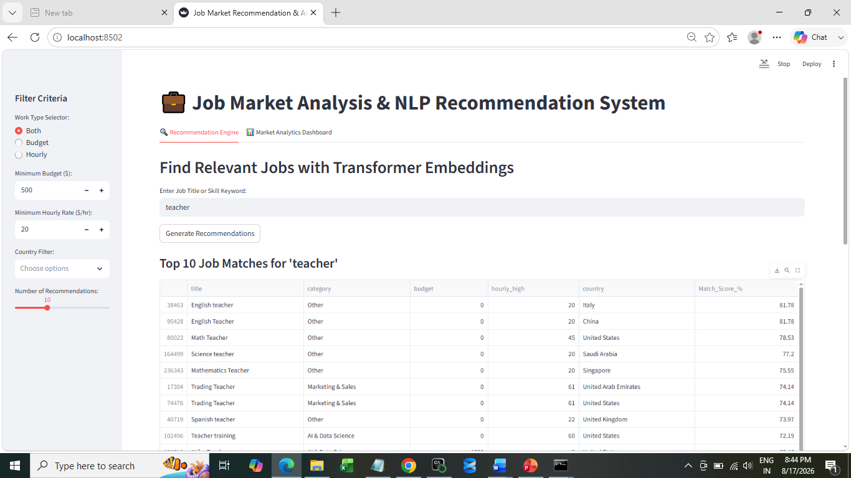
https://project---8-bhkadqqmjigxwcnpd5y34u.streamlit.app/ - Link for streamlit app

Slide 16


References & Technical Stack
Frameworks & Libraries
Literature & Standards
•
NLP & Transformers: HuggingFace Sentence-Transformers, NLTK, Scikit-Learn (TF-IDF).
•
Reimers & Gurevych (2019): Sentence-BERT: Sentence Embeddings using Siamese BERT-Networks.
•
Deep Learning: PyTorch 2.2.1, Multi-Layer Perceptron, LSTM.
•
Scikit-Learn Documentation: Linear Classification & Sparse Vector Space Models.
•
Deployment: Streamlit 1.32.0, Docker, Docker-Compose.
•
Streamlit & Docker Container Deployment Guidelines.

Slide 17
Thank You!
Job Market Analysis & NLP Recommendation System

